Slide 1
MISSION - TRACK BAR Atelier 2 6% de la note finale remise Colnet 9 février

Slide 2
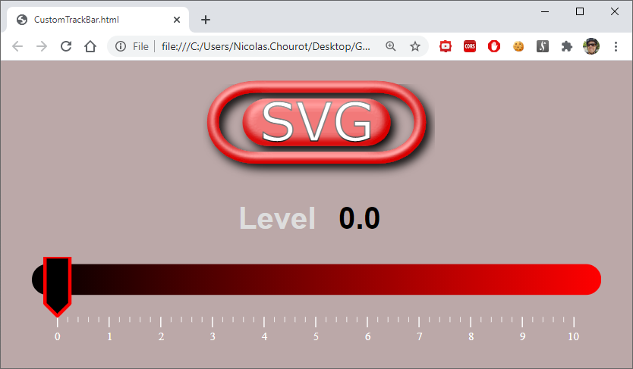
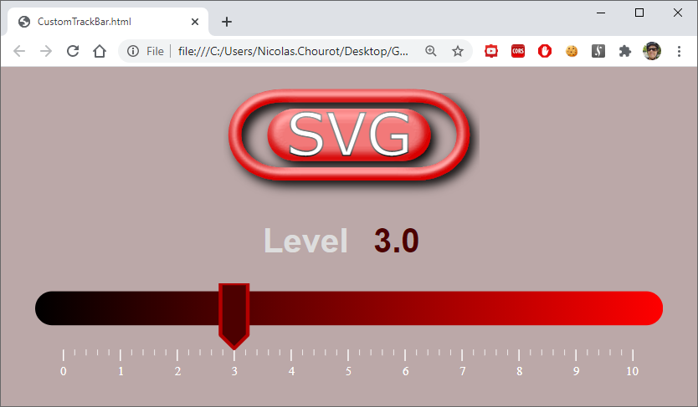
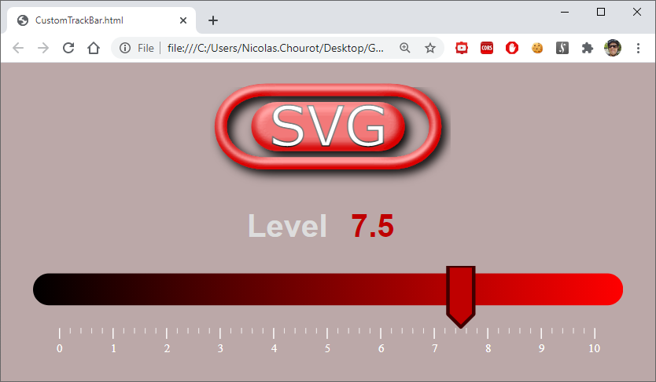

Slide 3
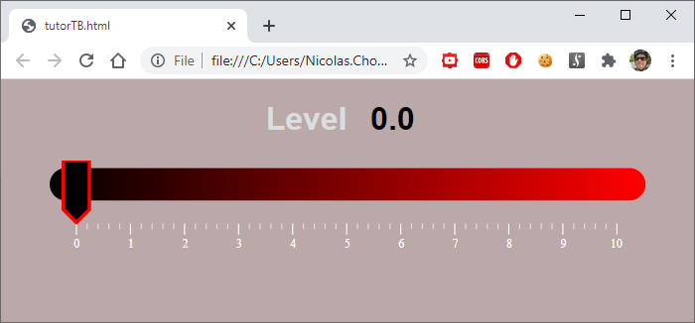
<!DOCTYPE html>
<html>
<header>
<style>
</style>
</header>
<body>
<div id="trackBarContainer" style="width:600px;">
<h1>Level <input type="text" id="level" value="0.0" /></h1>
</div>
</body>
<script>
</script>
</html>
<style>
body {
margin: 0;
background: rgb(187, 168, 168);
text-align: center;
color: #ddd;
font-family: Signika Negative, Asap, sans-serif;
}
#trackBarContainer,
svg {
display: block;
position: relative;
margin: 20px auto;
}
#cursor {
fill:rgb(0, 0, 0);
stroke-width: 7pt;
stroke:rgb(255, 0, 0);
stroke-linejoin: round;
cursor:grab;
}
#units {
font-size: 2em;
fill: white;
user-select: none;
}
#bigTicks {
stroke-width: 3px;
stroke:white;
}
#smallTicks {
stroke-width: 1px;
stroke:white;
}
#level {
font-size: 1em;
font-weight: bold;
width: 70px;
border: rgb(187, 168, 168);
border-radius: 8px;
text-align: center;
background: rgb(187, 168, 168);
}
</style>
TBSource.svg
#cursor
#trackbar

Slide 4
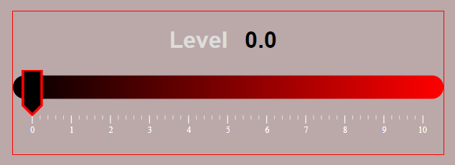
function extractViewBoxWidth(svg) {
return parseInt(svg.getAttribute("viewBox").split(" ")[2]);
}
<svg id="trackbar" viewBox="0 0 1562 255">
let cursorOrigin = 36;
let cursorWidth = 68;
let cursorOffset = cursorOrigin + cursorWidth / 2;
let maxPosition = 1417;
let smallUnit = maxPosition / 50;
68
Origine du curseur: 36
1417
<div id="trackBarContainer" style="width:600px;">
containerWidth = document.getElementById("trackbar").getBoundingClientRect().width

Slide 5
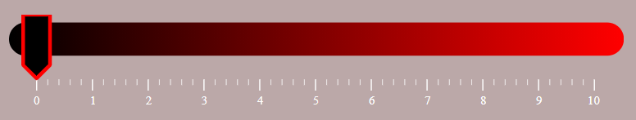
Coordonnées écran X
ÉcranAviewport = largeurConteneur / largeurViewport
CoordonnéesViewport X = Coordonnées écran X / ÉcranAviewport
CoordonnéesViewport X = Math.round(CoordonnéesViewport X / (smallUnit/2)) * (smallUnit/2)

Slide 6
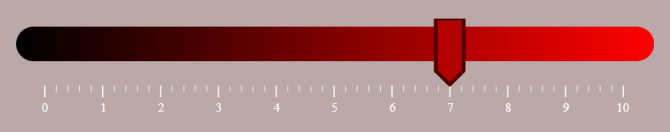
cursor = document.getElementById("cursor");
cursor.style.transform = "translate(" + viewportPositionX + 'px, 0px)';

Slide 7
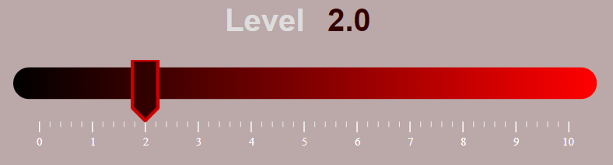
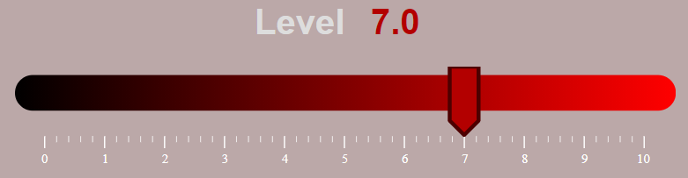
let levelValue = positionx / smallUnit * 0.2;
level.value = formatDecimal(levelValue, 1);
level.style.color = "rgb(" + levelValue / 10 * 255 + ",0 ,0)";
cursor.style.fill = "rgb(" + levelValue / 10 * 255 + ",0 ,0)";
cursor.style.stroke = "rgb(" + (255 - levelValue / 10 * 255) + ",0 ,0)";

Slide 8
let trackbar = document.getElementById("trackbar");
trackbar.addEventListener("pointerdown", function(e) {
e.target.setPointerCapture(e.pointerId);
...
mouseIsDown = true;
});
trackbar.addEventListener("pointermove", function(e) {
if (mouseIsDown) {
...
}
});
trackbar.addEventListener("pointerup", function(e) {
e.target.releasePointerCapture(e.pointerId);
mouseIsDown = false;
});
level = document.getElementById("level");
level.addEventListener("change", function(e) {
if (!mouseIsDown) {
...
}
});

